Slide 1

Project Title - SEASONAL AGRICULTURE PERFORMANCE ANALYSIS
Student Name – PRATHAMESH SANJAY LAMBATE
College Name – A. P. SHAH INSTITUTE OF TECHNOLOGY
AICTE STU ID : STU6130856d7f3251630569837

Slide 2

PROBLEM STATEMENT
Agriculture is highly dependent on seasonal and environmental conditions. Factors such as rainfall, temperature, humidity, soil moisture, sunlight, irrigation, fertilizer usage, pesticide application, crop selection and resource availability can vary significantly from one season to another. These variations can directly influence crop yield, production, water efficiency, revenue, cost and overall profitability.
The available agricultural dataset contains information about farming activities across different seasons, states, districts, crops, environmental conditions, resource usage, irrigation methods and economic outcomes. However, raw agricultural data does not directly explain how these factors interact or how agricultural performance changes between Kharif, Rabi and Zaid seasons.
The core problem is to transform raw seasonal agricultural data into meaningful, evidence-based insights that explain variations in agricultural performance and can support better seasonal agricultural planning and decision-making.
Therefore, the problem addressed by this project is to perform a systematic analysis of the agricultural dataset and identify meaningful seasonal patterns, trends, relationships, differences and unusual observations.

Slide 3
PROJECT DESCRIPTION
Data Analysis: Analyzes 4,000 agricultural records across Kharif, Rabi, and Zaid seasons to understand crop performance and seasonal variations.
Environmental & Resource Analysis: Examines factors such as rainfall, temperature, humidity, soil moisture, irrigation, fertilizers, pesticides, and water usage and their relationship with agricultural performance.
Performance & Economic Analysis: Compares yield, production, market price, revenue, cost, and profit across different seasons, crops, regions, and farming methods.
Insights & Recommendations: Uses data cleaning, statistical analysis, correlation analysis, and visualizations to identify important patterns, trends, relationships, and unusual variations, helping support better seasonal agricultural planning.

Slide 4

WHO ARE THE END USERS?
Farmers
Agricultural Planners
Government Departments
Irrigation & Resource Managers
Researchers
Data Analysts
Agribusinesses

Slide 5

TECHNOLOGY USED
Python
Pandas
NumPy
Matplotlib
Seaborn
SciPy
Scikit-learn
Google Colab

Slide 6
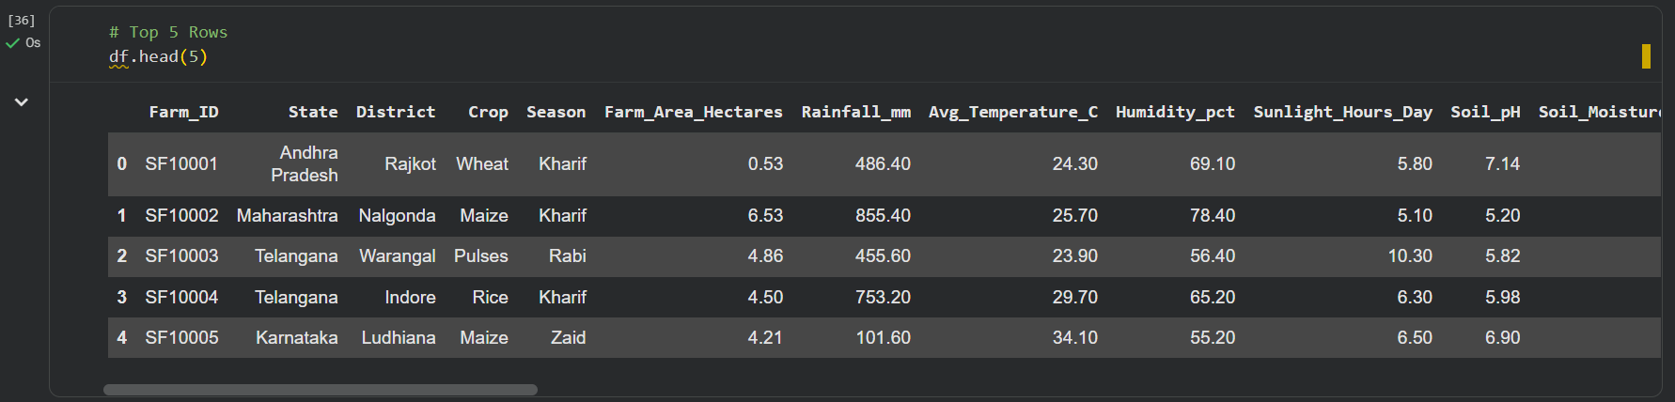
RESULTS
Top 5 Rows – Dataset Overview
The df.head(5) command displays the first five records of the agricultural dataset to understand its structure and the type of information available.
Each record represents a farm-level observation, containing details such as Farm ID, State, District, Crop, Season, and Farm Area.
The dataset includes important environmental parameters such as Rainfall, Average Temperature, Humidity, Sunlight Hours, and Soil pH, which help analyze seasonal agricultural conditions.
From these sample records, we can see different crops and seasons such as Wheat–Kharif, Maize–Kharif, Pulses–Rabi, Rice–Kharif, and Maize–Zaid across different regions.

Slide 7
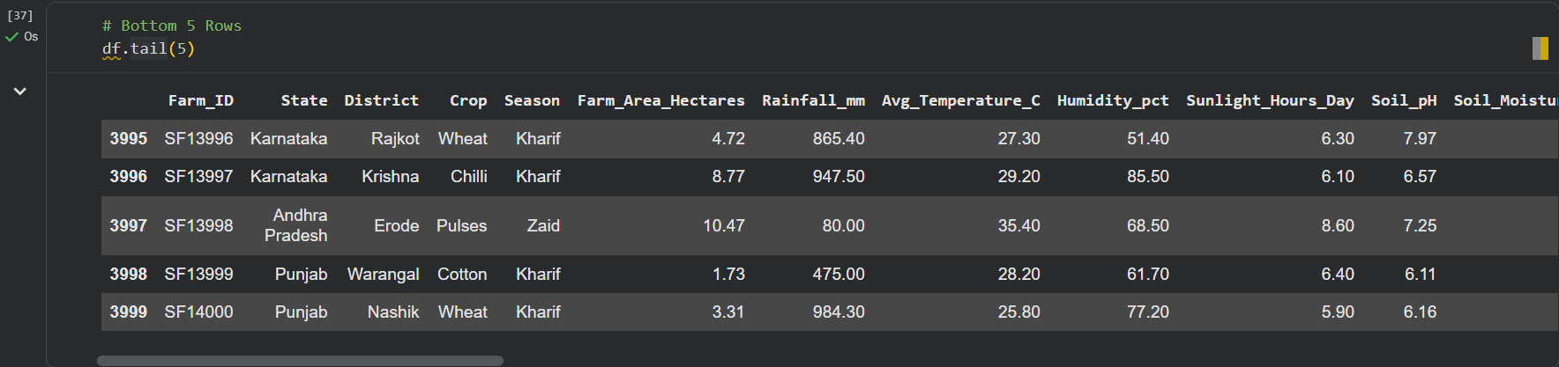
RESULTS
Bottom 5 Rows – Dataset Overview
The df.tail(5) command displays the last five records of the dataset to verify the ending portion of the data.
These records show farms from different states and districts, with crops such as Wheat, Chilli, Pulses, and Cotton across Kharif and Zaid seasons.
The rows contain important agricultural and environmental information, including farm area, rainfall, temperature, humidity, sunlight hours, and soil pH.
The final record has Farm ID SF14000, confirming that the dataset contains 4,000 records, indexed from 0 to 3999.

Slide 8
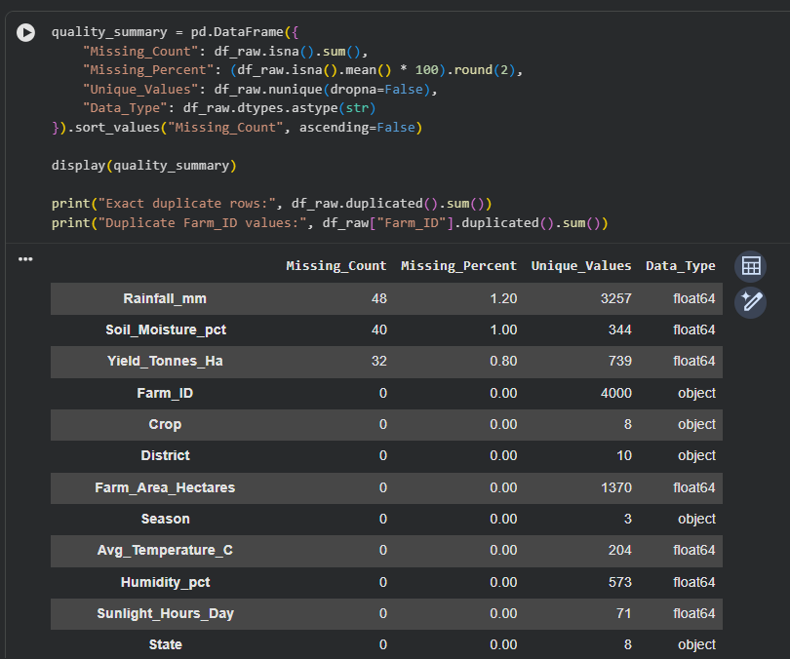
RESULTS
Data Quality Assessment
Missing Values: The dataset contains missing values in only three columns — Rainfall_mm (48 / 1.20%), Soil_Moisture_pct (40 / 1.00%), and Yield_Tonnes_Ha (32 / 0.80%). Other displayed columns have no missing values.
Unique Values: Farm_ID contains 4,000 unique values, while categorical fields such as Crop, Season, State, and District contain a limited number of unique categories.
Data Types: The dataset contains both numerical variables such as rainfall, soil moisture, farm area and yield, and categorical variables such as state, district, crop and season.
Duplicate Check: The code also checks for exact duplicate rows and duplicate Farm_ID values to ensure that each farm record is properly represented and avoid duplicate data affecting the analysis.

Slide 9
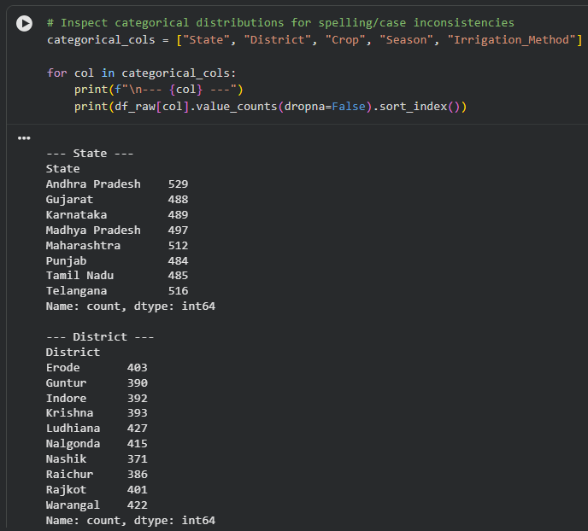
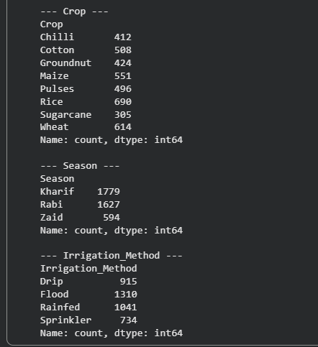
RESULTS
Categorical Data Distribution Analysis
State Distribution: The dataset covers 8 states, with records distributed relatively evenly. Andhra Pradesh has the highest number of records (529), while Punjab has the lowest (484).
District Distribution: The dataset includes 10 districts. Ludhiana has the highest representation (427 records), while Nashik has the lowest (371 records).
Consistency Check: The code checks categorical columns such as State, District, Crop, Season, and Irrigation Method for spelling or capitalization inconsistencies that could create duplicate categories during analysis.
Purpose: This step ensures that categorical data is standardized and reliable, helping produce accurate comparisons, visualizations, and seasonal analysis.

Slide 10
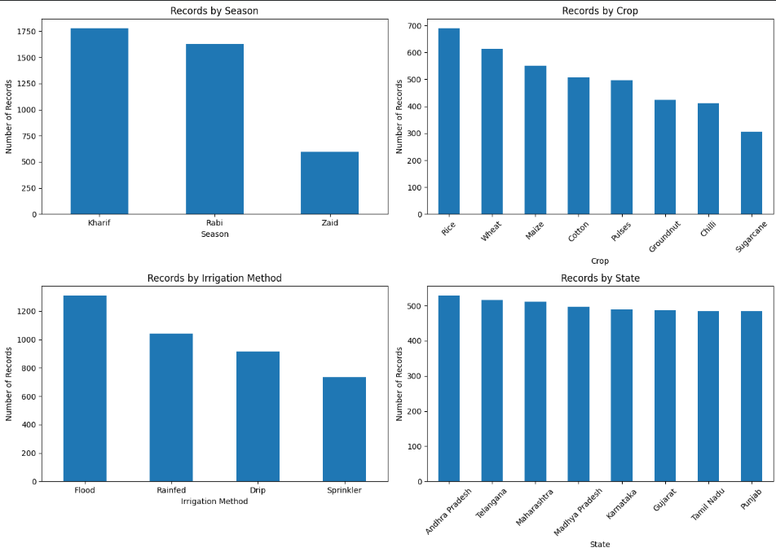
RESULTS
Categorical Distribution Analysis
Season Distribution: The dataset is mainly represented by Kharif (~1,780 records) and Rabi (~1,620 records), while Zaid (~600 records) has significantly fewer observations.
Crop Distribution: Rice has the highest number of records (~690), followed by Wheat (~610) and Maize (~550). Sugarcane has the lowest representation (~305).
Irrigation Methods: Flood irrigation (~1,310 records) is the most common method, followed by Rainfed (~1,050), Drip (~920), and Sprinkler (~730).
State Distribution: Records are fairly evenly distributed across the 8 states, with Andhra Pradesh (~530) having the highest representation and Punjab (~485) among the lowest.

Slide 11
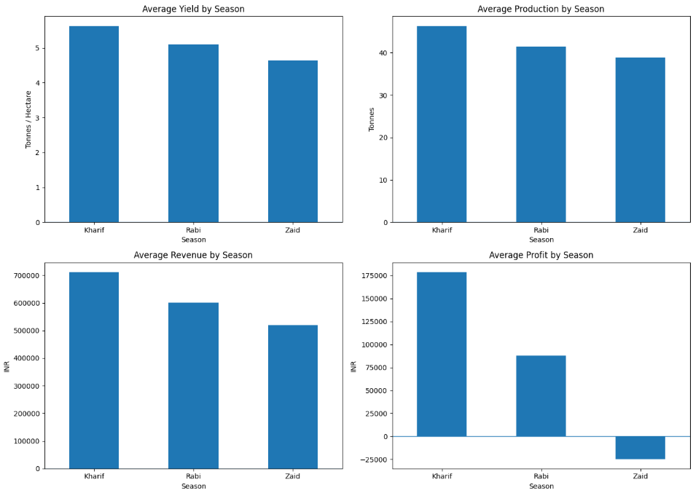
RESULTS
Seasonal Performance Analysis
Average Yield: Kharif records the highest average yield at approximately 5.6 tonnes/hectare, followed by Rabi (~5.1) and Zaid (~4.6). This indicates better crop productivity during Kharif.
Average Production: Kharif also has the highest average production at around 46 tonnes, followed by Rabi (~41 tonnes) and Zaid (~39 tonnes).
Average Revenue: Kharif generates the highest average revenue (~₹7.1 lakh), while Rabi generates around ₹6.0 lakh and Zaid around ₹5.2 lakh.
Average Profit: Kharif is the most profitable season with approximately ₹1.8 lakh average profit. Rabi generates around ₹0.9 lakh, whereas Zaid shows an average loss of approximately ₹25,000.

Slide 12
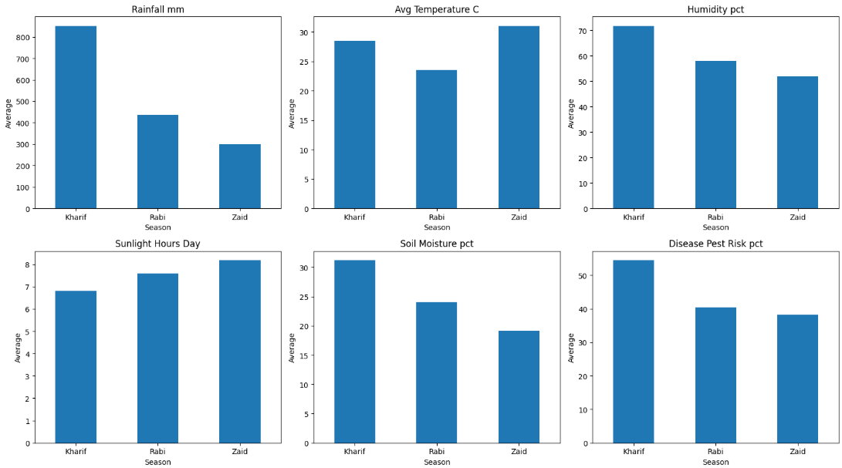
RESULTS
Environmental Conditions by Season
Rainfall: Kharif receives the highest average rainfall of approximately 850 mm, while Rabi receives around 440 mm and Zaid only 300 mm. This reflects the stronger availability of natural water during Kharif.
Temperature: Zaid is the hottest season (~31°C), followed by Kharif (~28.5°C), while Rabi is the coolest (~23.5°C).
Humidity & Soil Moisture: Kharif has the highest humidity (~72%) and soil moisture (~31%). Both values decline in Rabi and reach their lowest levels in Zaid.
Sunlight & Disease Risk: Zaid has the highest sunlight exposure (~8.2 hours/day) but the lowest disease/pest risk (~38%). Kharif has lower sunlight (~6.8 hours/day) but the highest disease/pest risk (~54%).

Slide 13
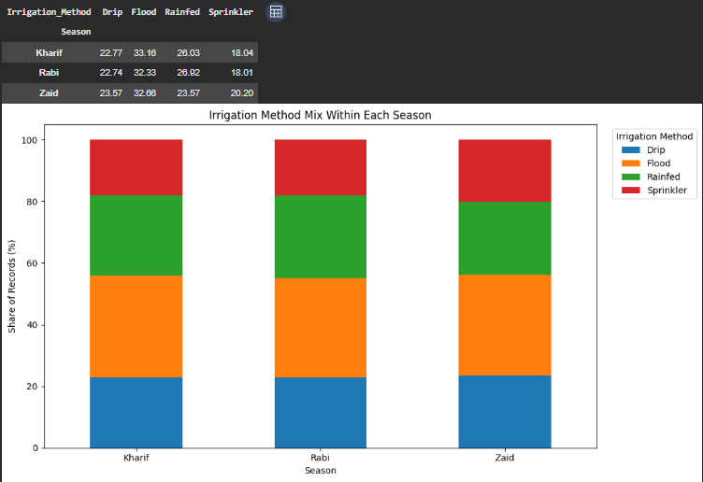
RESULTS
Irrigation Method Analysis by Season
Drip Irrigation: Drip contributes approximately 23% of records in Kharif and Rabi, increasing slightly to 24% in Zaid.
Flood Irrigation: Flood irrigation is the most widely represented method, accounting for around 33% in Kharif, 32% in Rabi, and 33% in Zaid.
Rainfed Farming: Rainfed farming represents approximately 26–27% across all three seasons, showing a relatively consistent distribution.
Sprinkler Irrigation: Sprinkler accounts for around 18% in Kharif and Rabi, increasing to approximately 20% in Zaid.

Slide 14
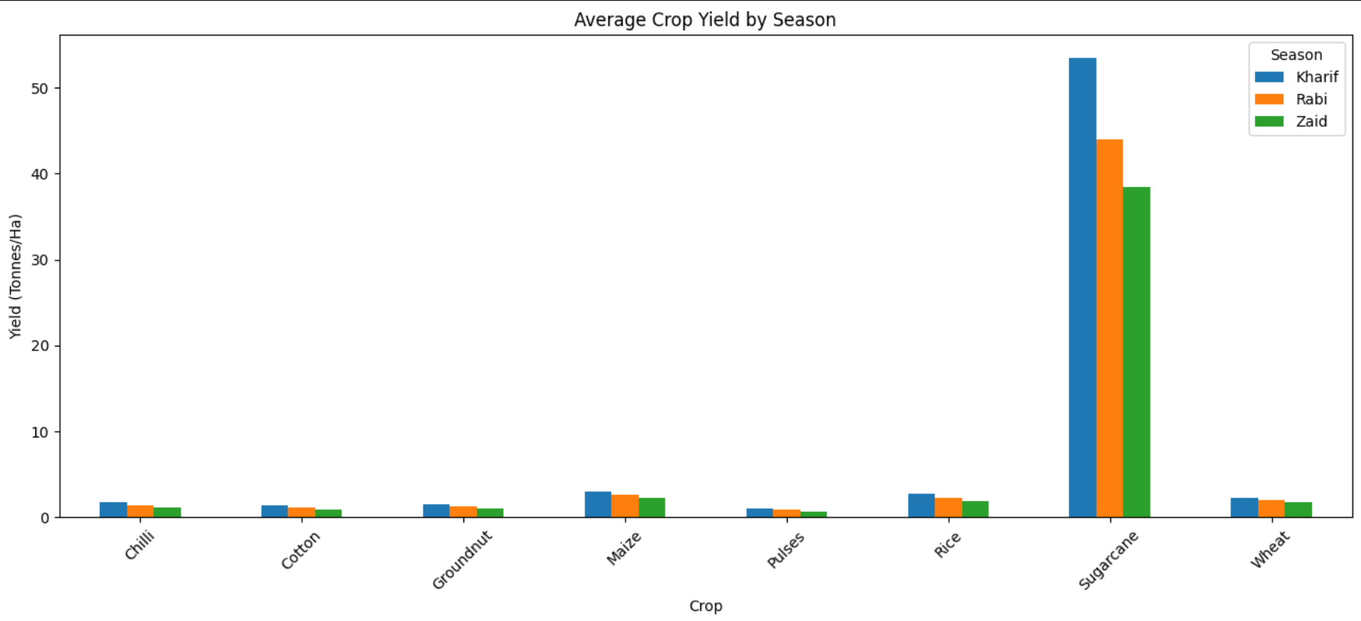
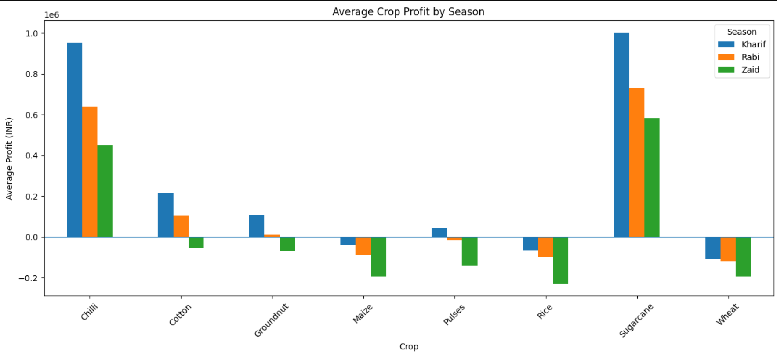
RESULTS
Crop Performance by Season
1. Average Crop Yield
Sugarcane has the highest yield in all three seasons, with Kharif (~53.5 tonnes/ha) performing better than Rabi (~44 tonnes/ha) and Zaid (~38.5 tonnes/ha).
Maize shows the next highest yield, followed by Wheat, Chilli, Groundnut, Cotton, Rice, and Pulses.
For most crops, Kharif records the highest yield, while Zaid generally records the lowest.
2. Average Crop Profit
Sugarcane and Chilli are the most profitable crops, particularly during the Kharif season.
Sugarcane generates the highest average profit, reaching approximately ₹10 lakh in Kharif, followed by ₹7.3 lakh in Rabi and ₹5.8 lakh in Zaid.
Maize, Rice, Wheat, and Groundnut show negative average profits in several seasons, especially Zaid, indicating lower economic performance.

Slide 15
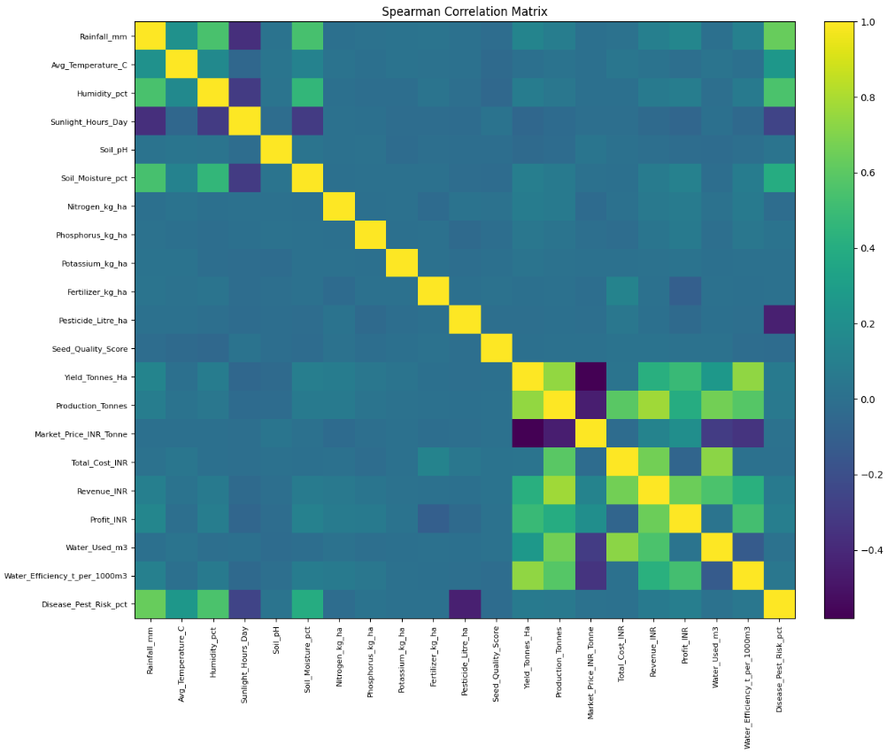
RESULTS
Spearman Correlation Analysis
Yield & Production: Yield_Tonnes_Ha and Production_Tonnes show a strong positive correlation, meaning farms with higher yield generally have higher total production.
Economic Relationships: Revenue_INR and Profit_INR show a strong positive relationship with production and yield. Total_Cost_INR also has a positive association with revenue, indicating that higher production activities are generally linked with higher costs and revenues.
Market Price Relationship: Market_Price_INR_Tonne shows a negative correlation with Yield and Production in this dataset. This suggests that higher production is often associated with lower market prices, although correlation does not imply causation.
Environmental Relationships: Rainfall_mm, Humidity_pct, and Soil_Moisture_pct show positive relationships, while Sunlight_Hours_Day tends to have negative relationships with rainfall, humidity, and soil moisture. This highlights clear differences in environmental conditions.

Slide 16
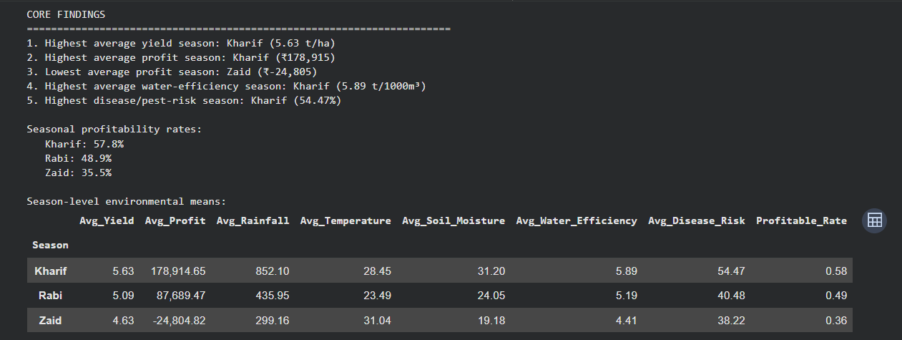
RESULTS
Core Findings – Seasonal Agriculture Performance
Kharif – Best Overall Performance: Kharif has the highest average yield (5.63 t/ha) and highest average profit (₹178,915). It also has the highest water efficiency (5.89 t/1000 m³).
Rabi – Moderate Performance: Rabi records an average yield of 5.09 t/ha and average profit of ₹87,689. Its profitability rate is 48.9%, placing it between Kharif and Zaid.
Zaid – Lowest Profitability: Zaid has the lowest average yield (4.63 t/ha) and records an average loss of ₹24,805. Its profitability rate is only 35.5%, indicating weaker economic performance.
Environmental & Risk Differences: Kharif has the highest rainfall (852.10 mm), soil moisture (31.20%) and disease/pest risk (54.47%). Zaid has the highest temperature (31.04°C) but the lowest rainfall and soil moisture.

Slide 17
FUTURE SCOPE
Real-time weather integration for dynamic seasonal analysis.
Machine-learning-based yield prediction using environmental and farming variables.
Profit prediction to estimate expected economic outcomes.
Crop recommendation system based on seasonal and soil conditions.
Smart irrigation recommendations to improve water efficiency.
Power BI interactive dashboard for real-time exploration.
GIS-based geographical analysis of crop yield and profitability.
Disease and pest risk prediction for early warning.
Multi-year analysis to identify long-term agricultural trends.
Farmer decision-support application for practical field-level recommendations.

Slide 18
GitHub Link
https://github.com/LambatePrathamesh/Seasonal-Agriculture-Performance-Analysis.git

Slide 19

VOIS Course completion certificate - Course name- Data Visualization

Slide 20
Thank You
.
.

